Slide 1
PF Semester Project Project Title: Multiplayer Tic Tac Toe
Team Members:
1. Muhammad Umair Nadeem.
2. Muhammad Mansoor.

Slide 2
Introduction
This game is played between two users.
Each user has it own console.
Both consoles have same IP and connected by sockets.
Each send packets to each other by using TCP protocol.

Slide 3
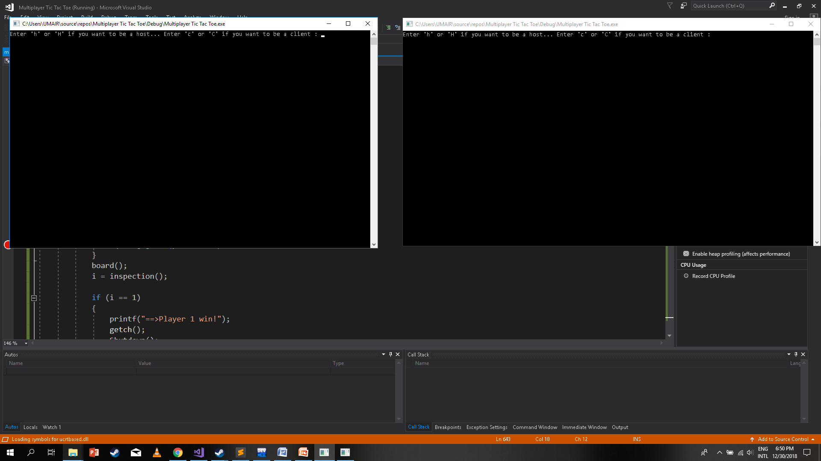
Consoles

Slide 4
Get Started
One of the player plays as a host and other one as a client.
Host is player one and has a mark (X).
Client is player two and has a mark (O).

Slide 5
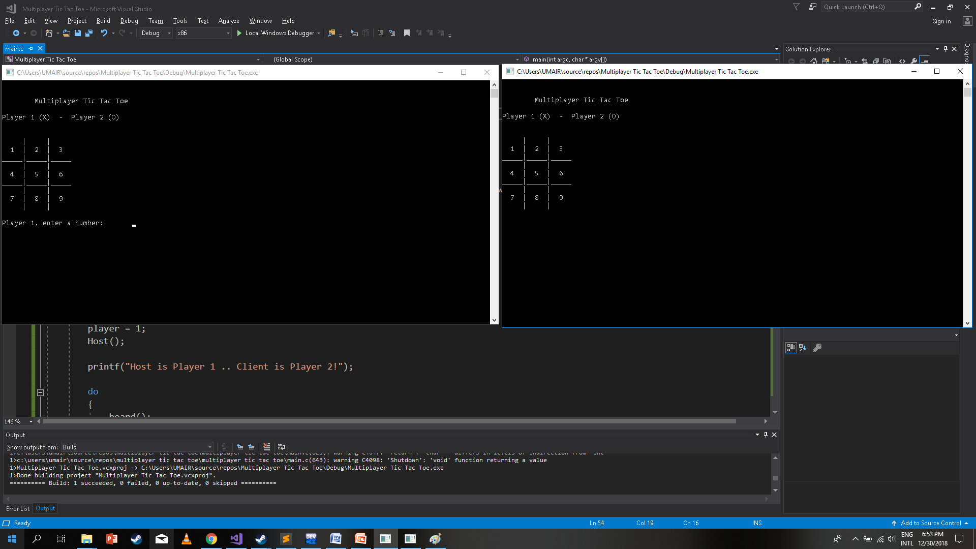

Slide 6
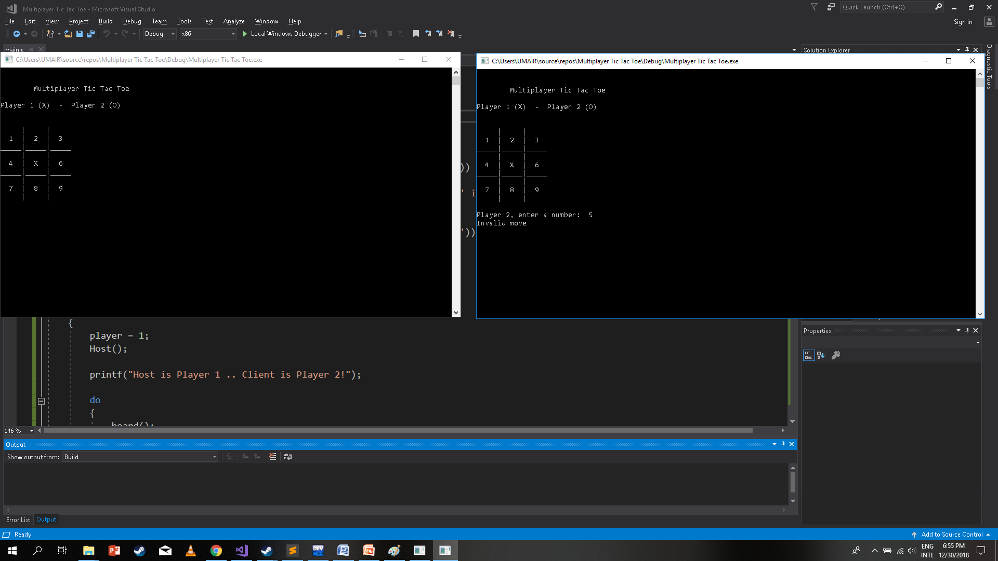
Overwrite error

Slide 7
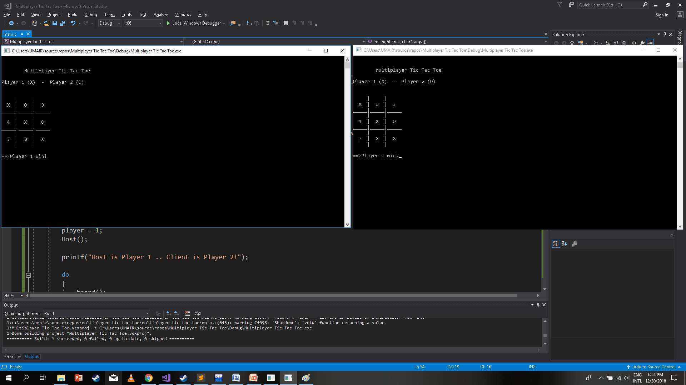
Win!

Slide 8
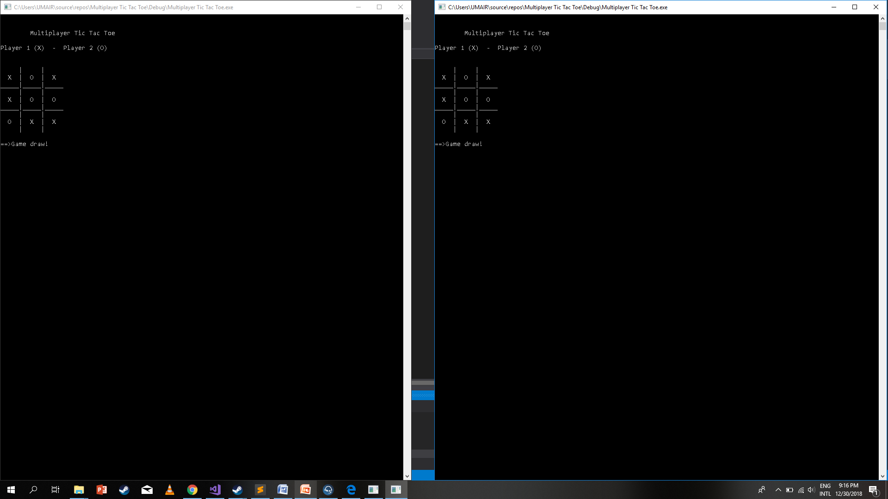
Draw

